Slide 1

Title: Implement the KNN Classifier
Software Engineering Project
Presented by:
Guided by:
Kashif Hussain - 1470503
Fahad Jabbar - 1502431
Naila Shaheen - 1439609
Prof. Damir Dobric

Slide 2
Table of Content:
Introduction to KNN classifier
KNN classifier’s native implementation
KNN classifier’s integration with Neocortex Api & Unit testing
KNN classifier on SP generated SDRs & Unit testing
Conclusions

Slide 3
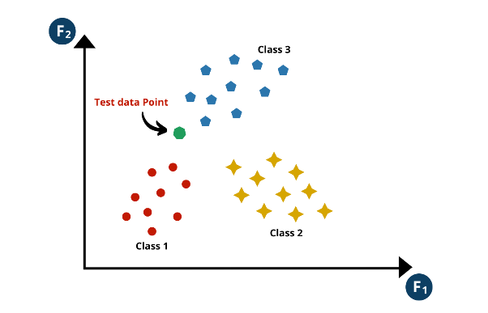
Introduction to KNN Classifier
KNN classifier operates by classifying the data point based on the majority class of its nearest neighbors in the feature space.
In essence, the KNN classifier assigns the class label of the majority of its k nearest neighbors to the new data point, making it a non-parametric and instance-based learning method.
New datapoint to be classified is introduced into the KNN classifier

Slide 4
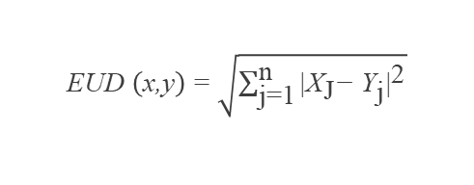
Important Parameters in KNN Classifier
The working of a KNN classifier depends on multiple parameters as explained below:
Value of K: The choice of K in the K-nearest neighbors (KNN) classifier influences the prediction by considering a specified number of neighboring data points. Odd values are often favored to prevent tie situations during voting, ensuring unambiguous class assignments.
Distance Metrics: The distance metric in K-nearest neighbors (KNN) classification defines how distances between the two data points are measured, We've employed the Euclidean distance method, one of several available, to measure distances between data points, which is given by:
Voting Scheme: In the k-nearest neighbors (kNN) algorithm, the voting scheme involves assigning a class label to a data point based on a majority or weighted vote from its k nearest neighbors.
Cross-Validation Parameters: Cross-validation parameters, including the number of folds and scoring metric choice, are crucial for evaluating the KNN classifier's performance and preventing overfitting.
EUD $\left(\text{x}\text{,}\text{y}\right)\text{ = }\sqrt{\sum_{\text{j}\text{=1}}^{\text{n}}{{\text{|}{\text{X}}_{\text{J}}\text{−} {\text{Y}}_{\text{j}}\text{|}}^{\text{2}}}}$

Slide 5
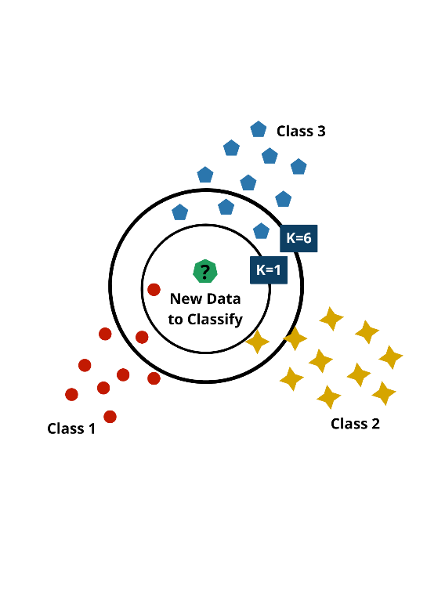
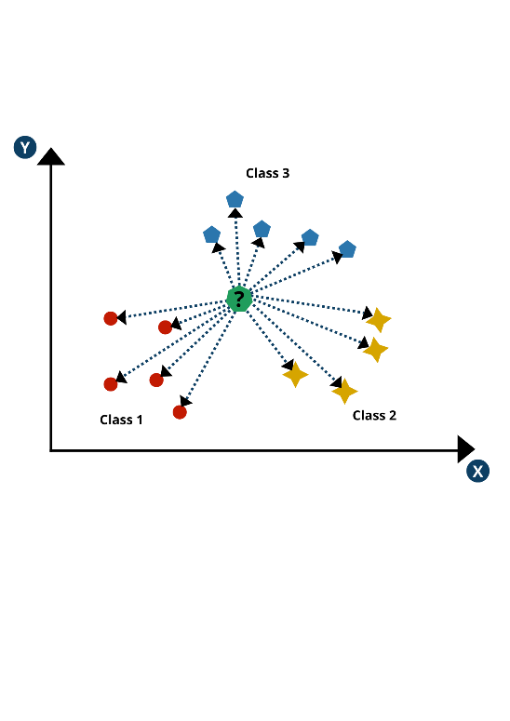
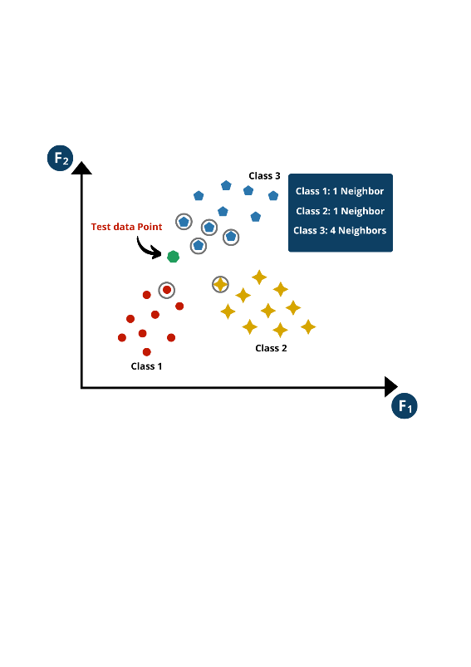
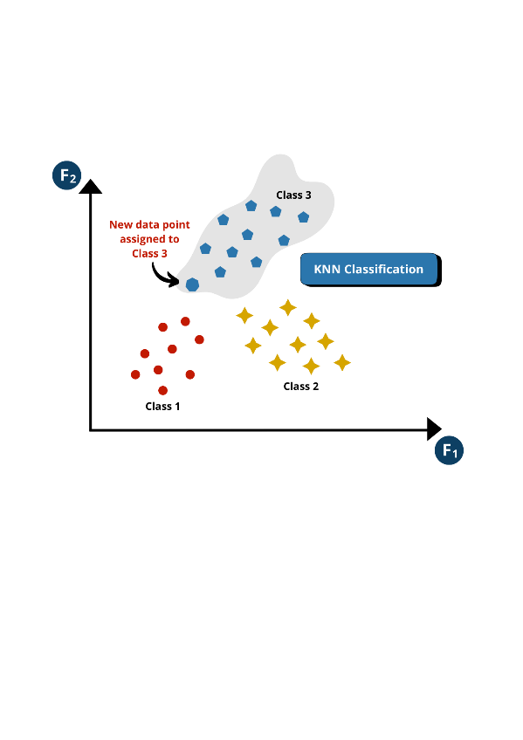
KNN Classifier Working Principle
Step 1: Selecting the value of K for KNN
Step 2: Distance calculation for each data point
Impact of value k on KNN classification
Calculated distance for each data point
Step 3: Voting and Prediction for new data point
Step 4: Predicting the Class of the new data point
Voting based on the distance calculated
Assignment of class after majority voting

Slide 6
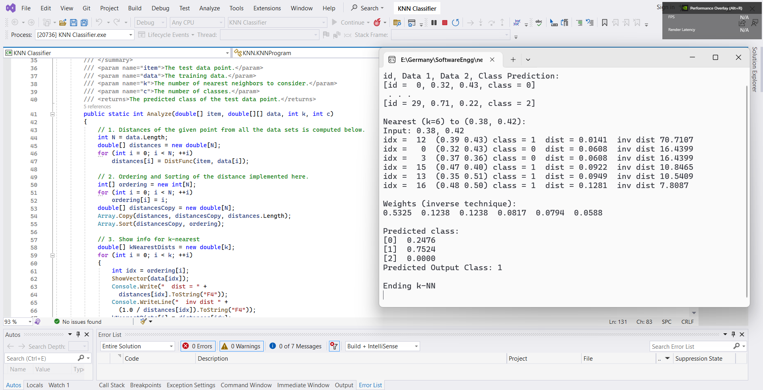
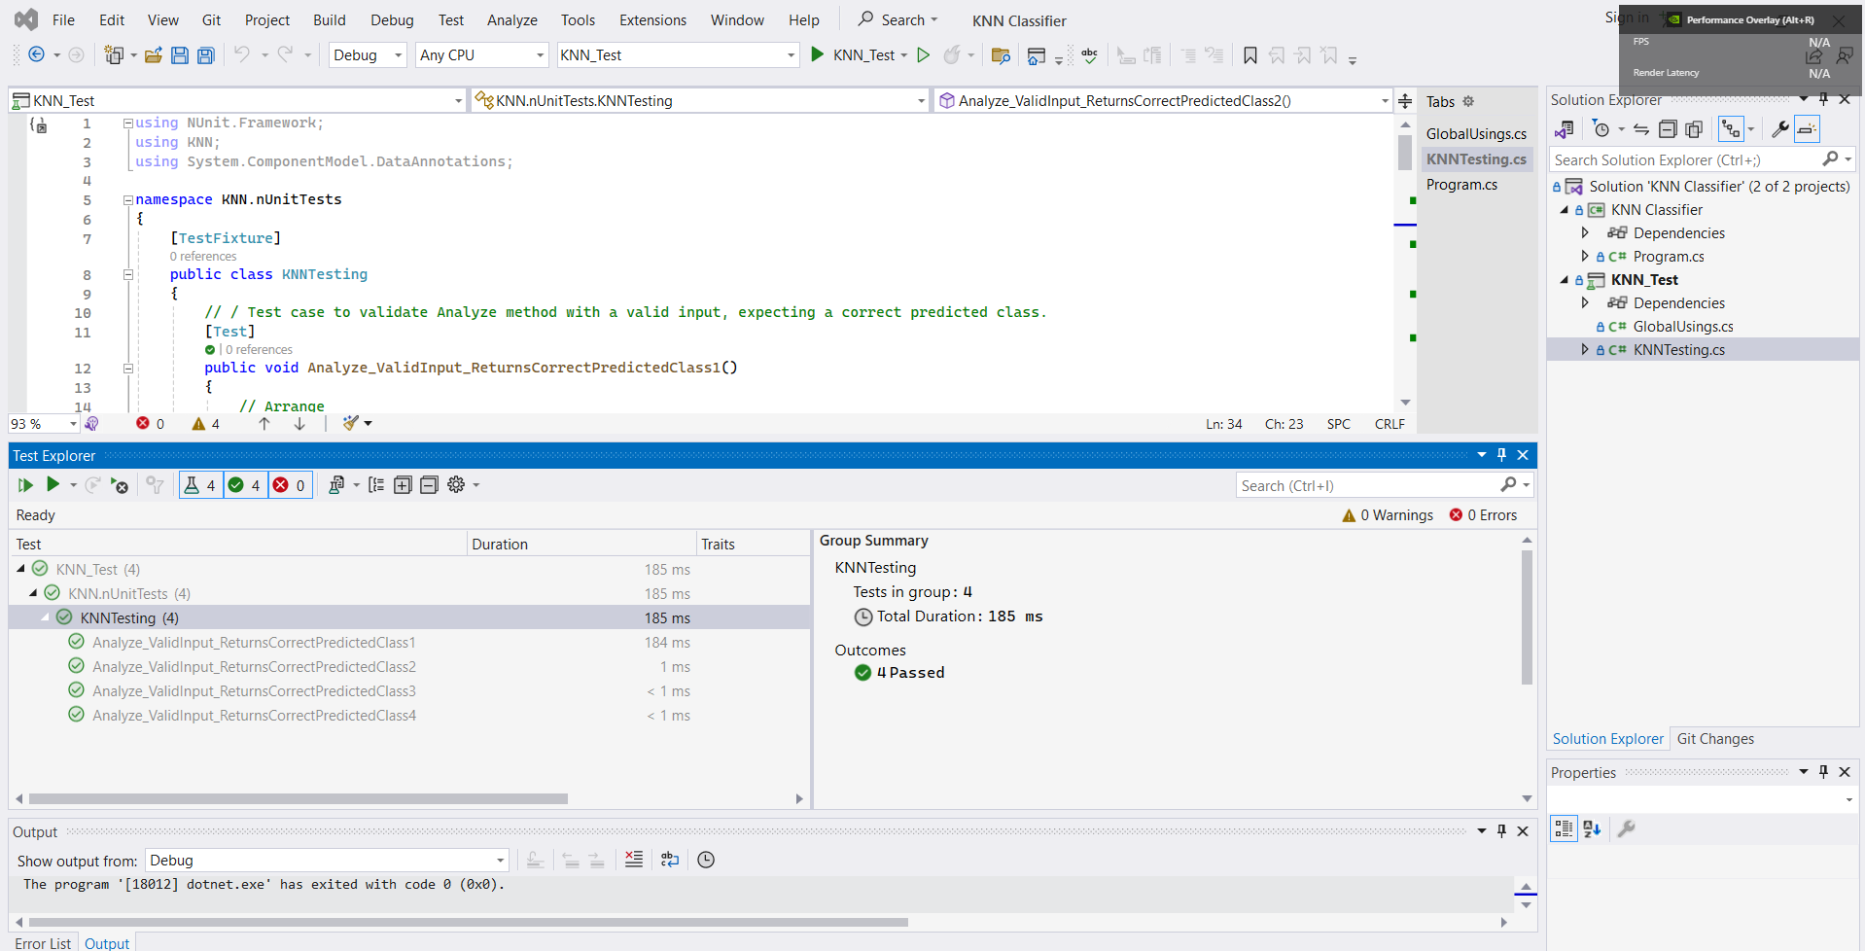
Results and Unit Test for Native KNN Classifier
The model takes two dimensional data points with three different classes and classifies the new data point using the KNN classifier.
Native KNN Classifier Output
Unit Tests for Native KNN Classifier

Slide 7
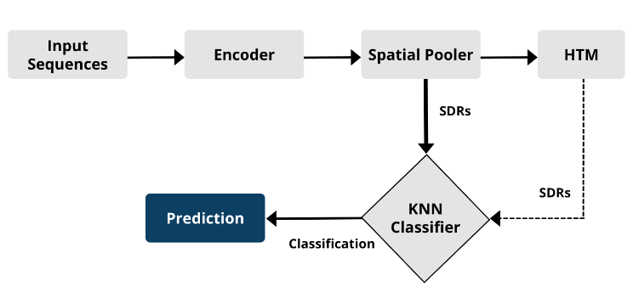
Integration of KNN with Neocortex API
A comprehensive framework for sequence learning and classification incorporates an encoder, Spatial Pooler, Temporal Memory, and K-nearest neighbor (KNN) classifier.
KNN classifier integration with Neocortex API

Slide 8
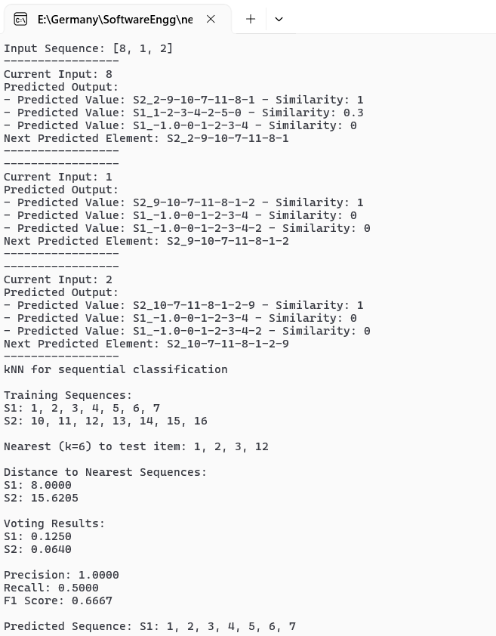
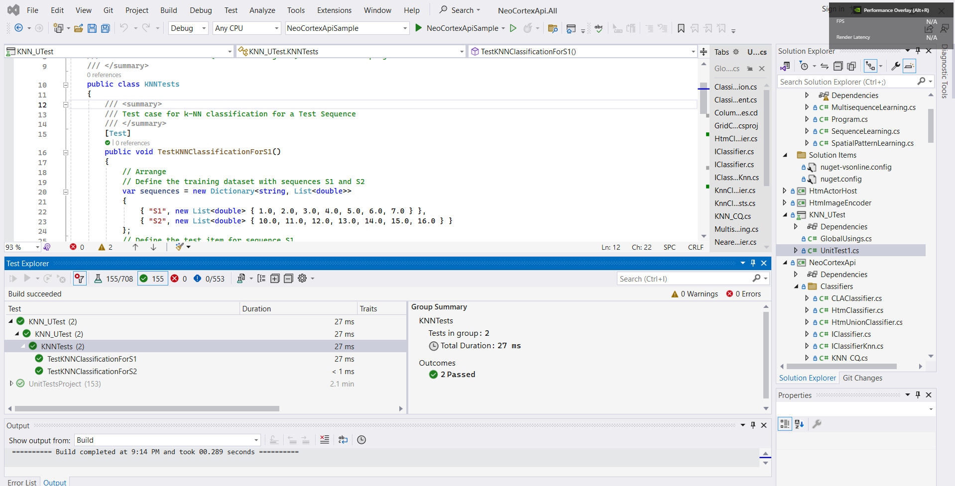
Results and Unit Test for KNN integrated with Neocortex API
KNN classifier integration with Neocortex API
Unit tests for KNN classifier with Neocortex API

Slide 9
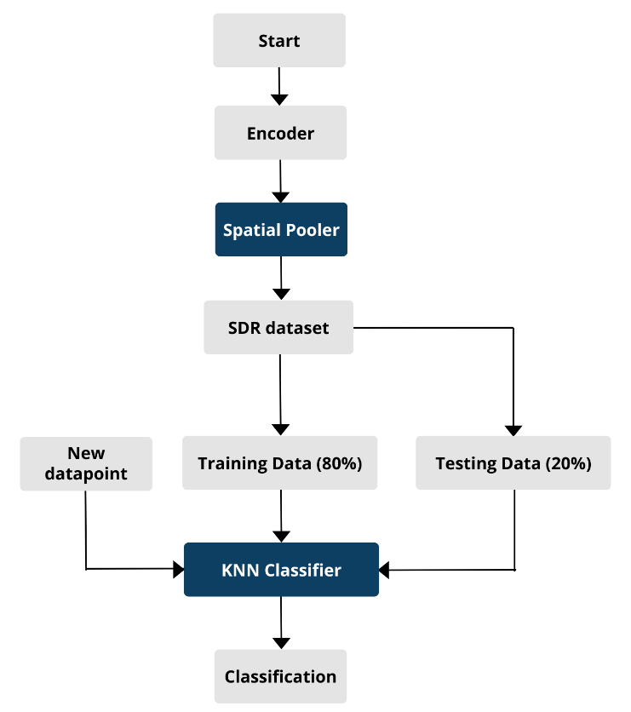
KNN classifier with Spatial Pooler generated SDRs
From the Spatial Pooler Learning Experiment, the dataset for SDRs is obtained and split into 80% and 20% for training and testing respectively.
5-fold cross validation is used to train a KNN classifier using the training data and evaluates its accuracy on the testing data to evaluate how it behaves on different folds of training and testing datasets.
The results obtained from the 5-fold cross-validation revealed a classification accuracy of 90%. This high accuracy level indicates the model's ability to make accurate predictions on unseen data instances across the different folds of the cross-validation process.
The KNN classifier, after being trained on 80% of the dataset, is able to accurately predict the output of a new data point with 100% accuracy when value of k is 3 and wit 85% accuracy when the value of k is set to 6.
Process diagram for KNN classification with SP generated SDRs

Slide 10
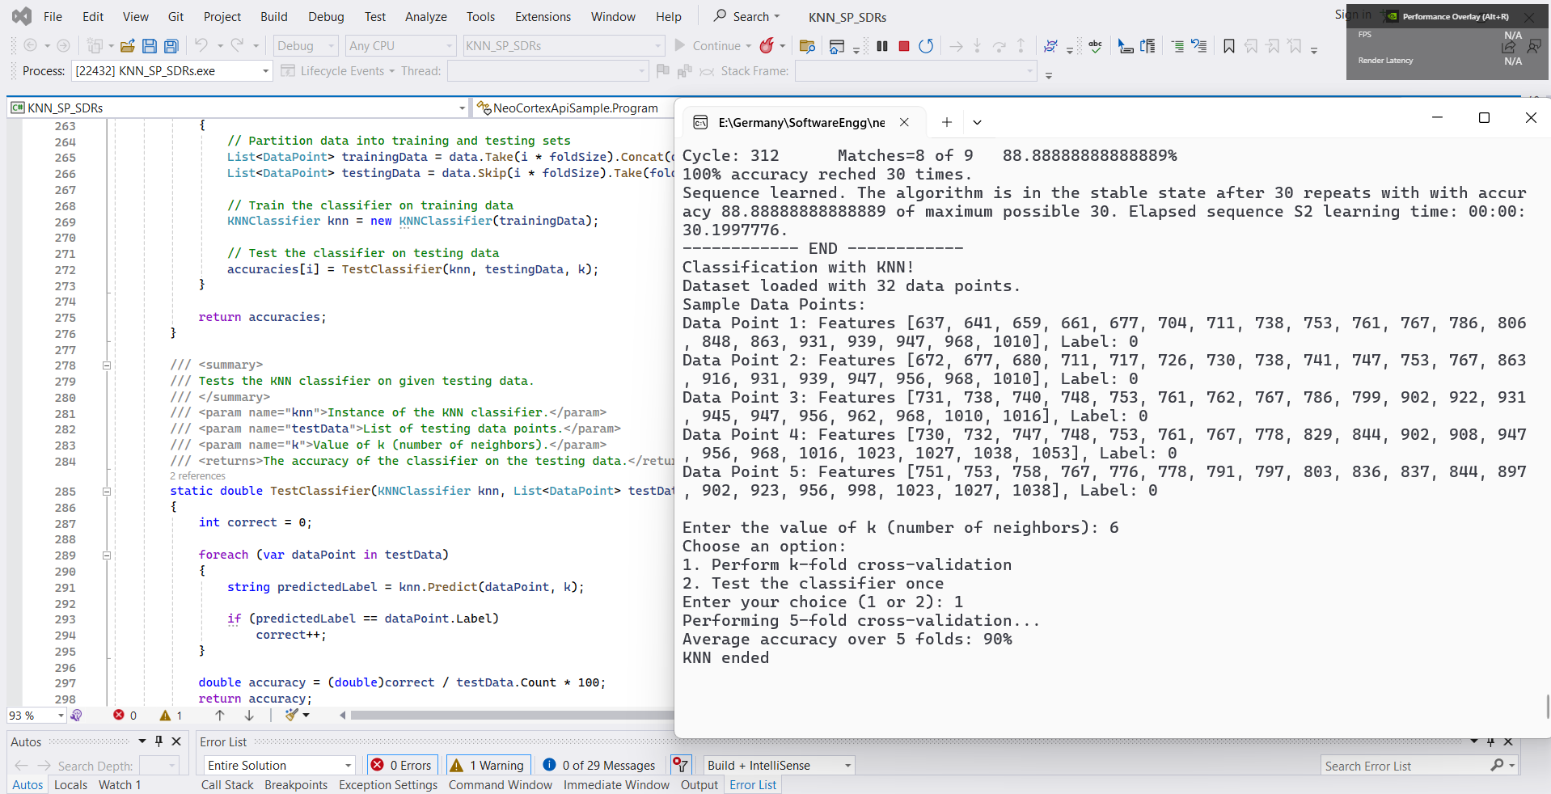
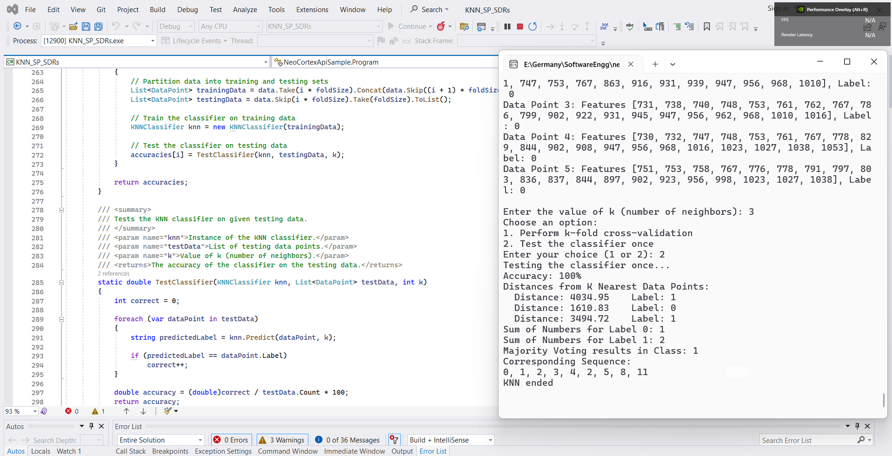
KNN Classifier with Spatial Pooler generated SDRs
Results for 5-fold cross validation
KNN classifier prediction when SP generated SDRs are fed

Slide 11
KNN Classifier with Spatial Pooler generated SDRs
The accuracy of the KNN model is closely tied to the choice of the k parameter, and finding the optimal value of k is an important step in the model development process.
The optimal value of k is typically determined through a process of cross-validation or other model selection technique-s, as it can vary depending on the specific dataset and problem at hand.
The figure shows the trade off and impact evaluation for values of k on KNN classifier results.
Value of k (integer) | Accuracy of prediction in percentage (%)
1 | 100
2 | 100
3 | 100
4 | 100
5 | 89
6 | 85
Impact of k on the accuracy of the model

Slide 12
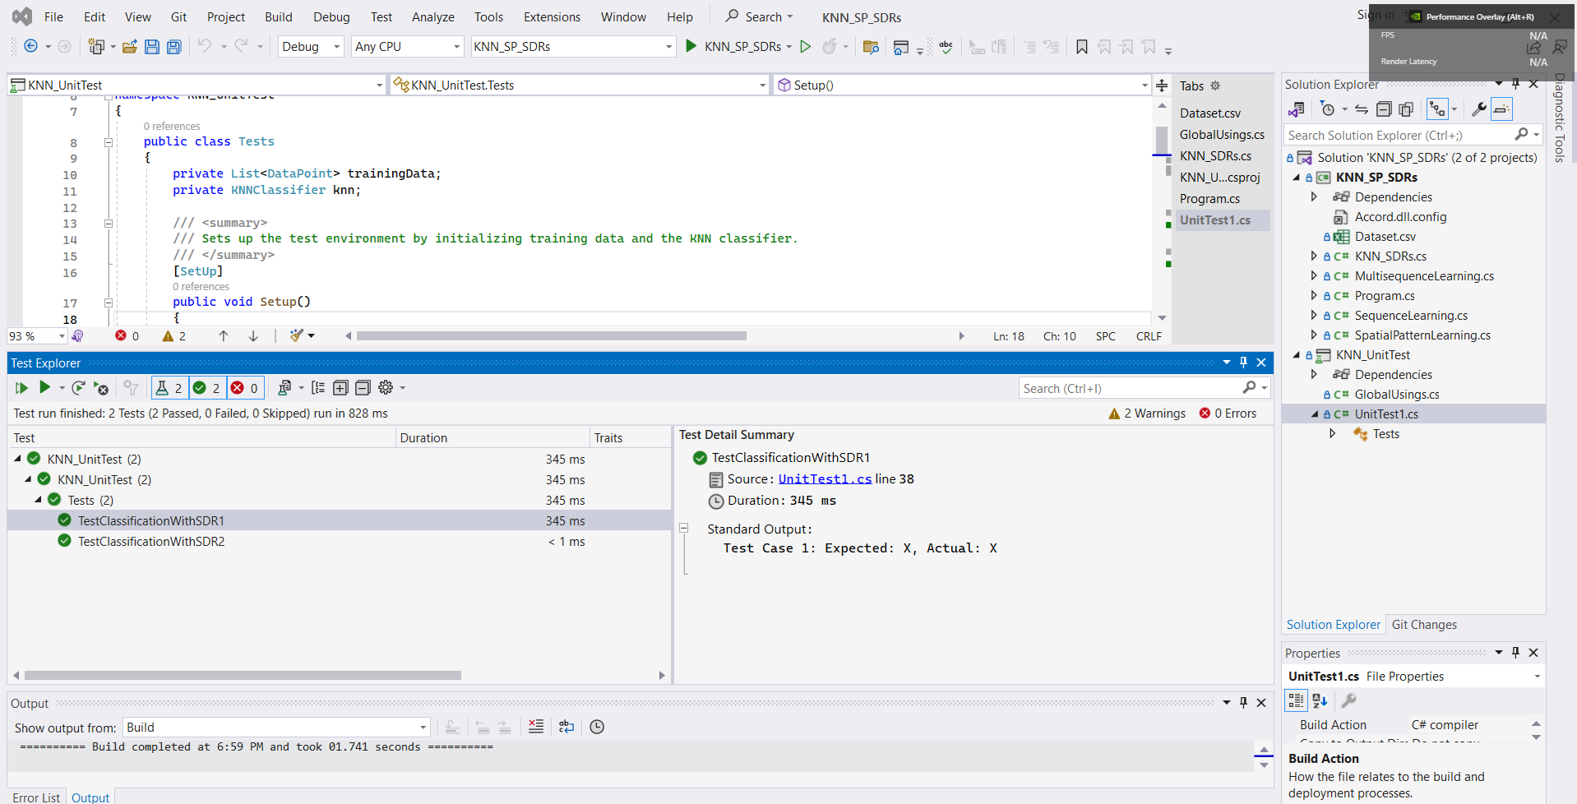
KNN Classifier with Spatial Pooler generated SDRs - Unit Testing
Unit tests for KNN classifier on SP generated SRDs

Slide 13
Conclusions
The research introduces K-Nearest Neighbors (KNN) classification within the Neocortex API framework, inspired by neocortical information processing.
By integrating spatial pooling and hierarchical temporal memory (HTM), the method enhances the classification of sequential data streams.
Through rigorous testing and integration with the Neocortex API, the study consistently demonstrates the model's effectiveness, achieving a commendable 90% accuracy rate across varied scenarios.
These findings underscore the potential of neuromorphic-inspired frameworks in advancing sequential data analysis.
Moving forward, optimizing performance and exploring broader applications remain promising areas for future research, reflecting the ongoing convergence of traditional machine learning and biologically inspired computational models.

Slide 14

Thank You

